Slide 1
FIFO depth calculation
By sravanthi
Chipweave technologies pvt lmd

Slide 2
Introduction
Asynchronous FIFO is required when two modules operate in different clock domains and data must be safely transferred without loss
FIFO is mainly needed when the write side is faster than the read side, so unread data can be buffered.
FIFO depth must be sufficient to store data that the slower module cannot read during the write period.
FIFO depth equals the maximum number of data items written but not read during the worst-case burst scenario.
To size a FIFO correctly, you must know burst size, burst rate, write frequency, and read frequency.

Slide 3
Burst size = number of data items written continuously
Burst Rate=How often bursts occur (bursts per second)
Write Frequency=This tells you how fast data is written into the FIFO
Read Frequency=This tells you how fast data is removed from the FIFO

Slide 4
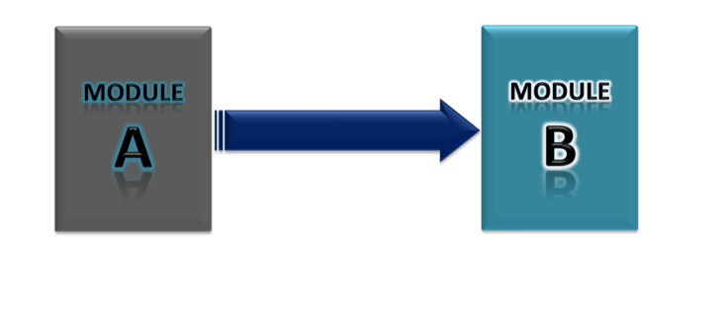
In the following examples, I considered that, the module ‘A’ wants to send some data to the module ‘B’.

Slide 5
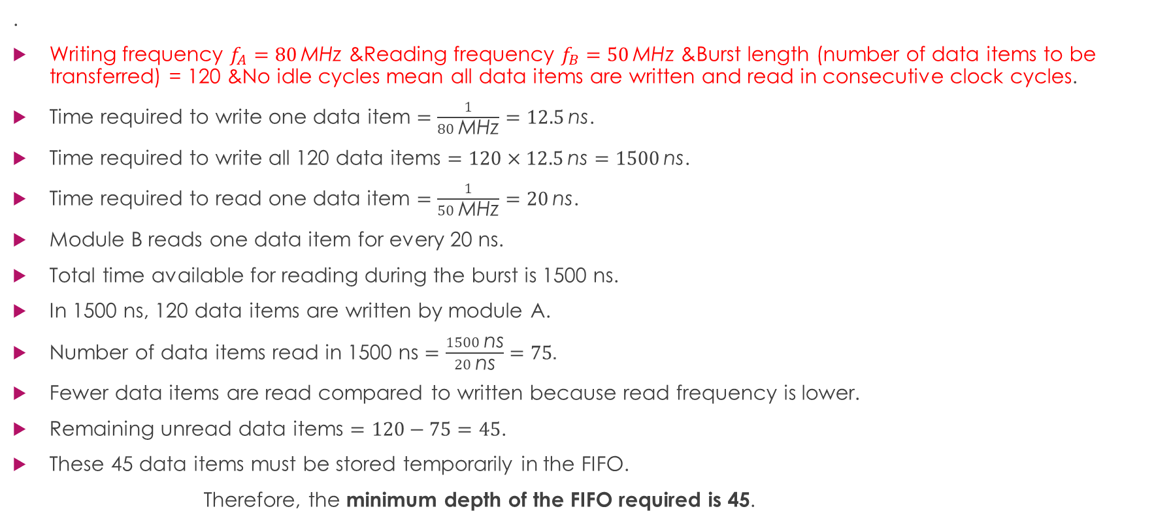
Case–1: $f_{A}$ >$f_{B}$with no idle cycles
.
Writing frequency $f_{A}=80 \text{MHz}\text{ \&}$Reading frequency $f_{B}=50 \text{MHz}\text{ \&}$Burst length (number of data items to be transferred) = 120 &No idle cycles mean all data items are written and read in consecutive clock cycles.
Time required to write one data item $=\frac{1}{80 \text{MHz}}=12.5 \text{ns}$.
Time required to write all 120 data items $=120×12.5 \text{ns}=1500 \text{ns}$.
Time required to read one data item $=\frac{1}{50 \text{MHz}}=20 \text{ns}$.
Module B reads one data item for every 20 ns.
Total time available for reading during the burst is 1500 ns.
In 1500 ns, 120 data items are written by module A.
Number of data items read in 1500 ns $=\frac{1500 \text{ns}}{20 \text{ns}}=75$.
Fewer data items are read compared to written because read frequency is lower.
Remaining unread data items $=120−75=45$.
These 45 data items must be stored temporarily in the FIFO.
Therefore, the minimum depth of the FIFO required is 45.

Slide 6
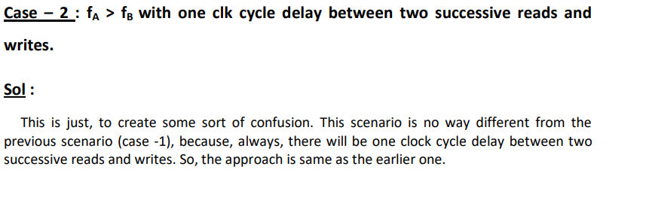
Case 2

Slide 7

Case 3:$f_{A}>f_{B}$with idle cycles
Writing frequency fA=80 and reading frequency fB=50 MHz &Burst length (number of data items to be transferred) = 120 &Number of idle cycles between two successive writes = 1 &Number of idle cycles between two successive reads = 3.
One idle read sequence means one data is read every four read clock cycles.
One idle write cycle means one data is written every two write clock cycles.
Time required to write one data item =2×180 MHz=25 ns
Time required to write all 120 data items =120×25 ns=3000 ns
Time required to read one data item =4×150 MHz=80 ns
Module B reads one data item for every 80 ns.
Number of data items read in 3000 ns =300080=37.5≈37
Remaining unread data items to be stored in FIFO =120−37=83.
Therefore, the minimum depth of the FIFO required is 83.

Slide 8
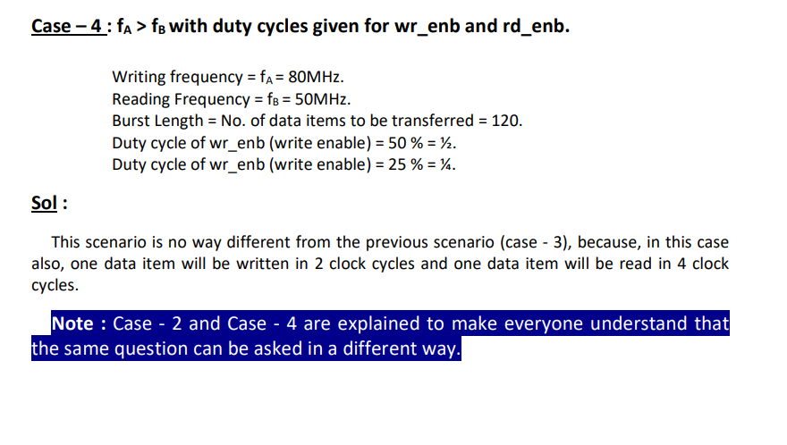
Case 4

Slide 9
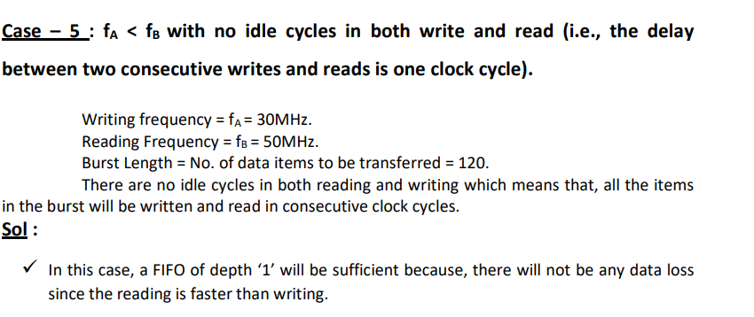
Case 5

Slide 10
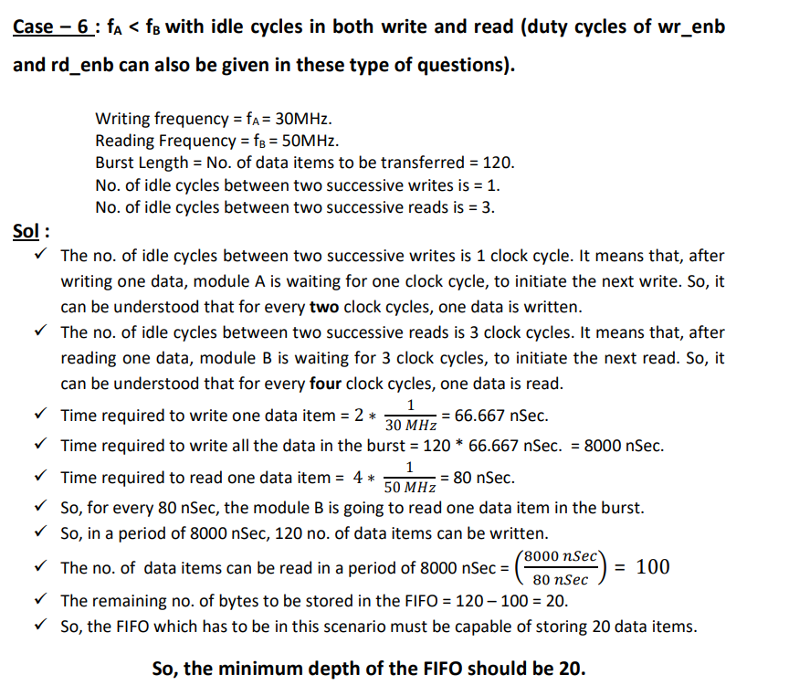
Case 6

Slide 11
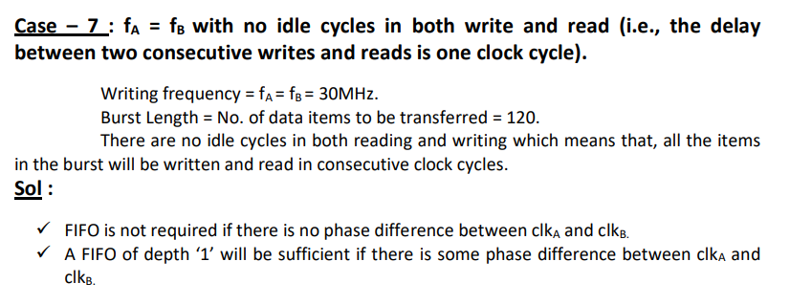
Case 7

Slide 12
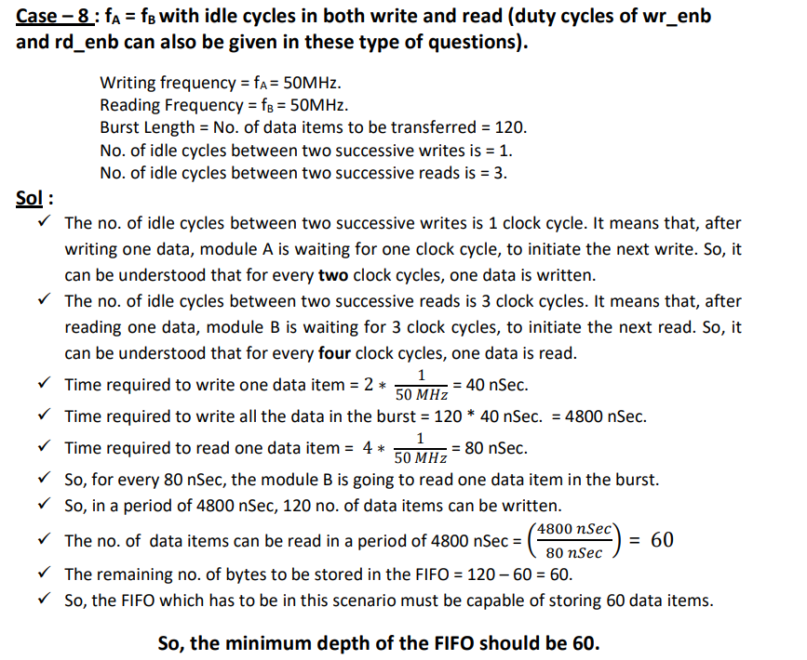
Case 8

Slide 13
Case 9

Slide 15
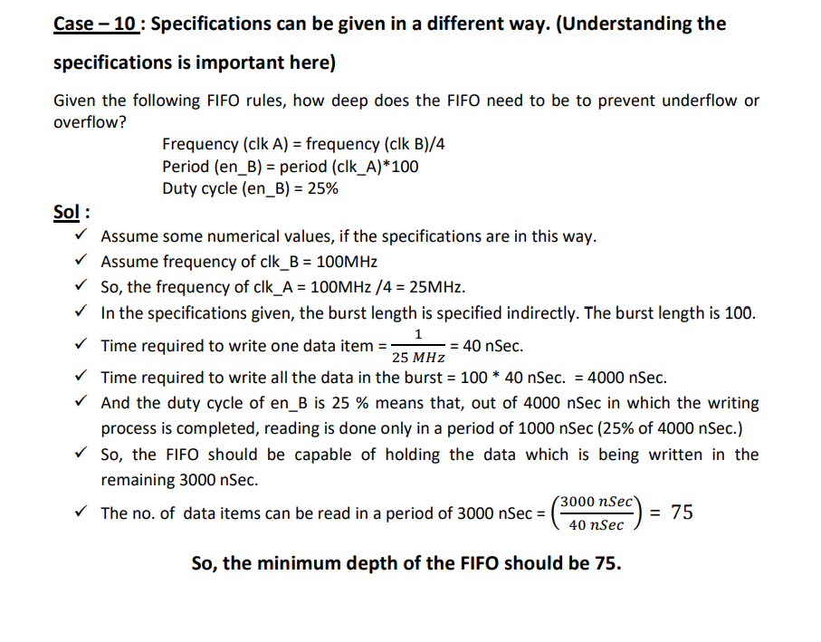
Case 10

Slide 16


